Slide 1
D606: Data Science Capstone Detecting Anomalous SEC Filings to Identify Financial Risk
Bernard Connelly
Master of Science, Data Analytics, Western Governor’s University
Dr. Daniel Smith
July 07, 2025

Slide 2

Who am I?
Former Behavior Analyst. Currently employed in Compliance and Risk in the Financial Operations Industry
User of excel & visualizations for nearly 2 decades
Lover of all things nerd, including board games, video games, and data!
Happily married father, of 2 boys seen here!

Slide 3

Hypothesis and Research Question
The Securities and Exchange Commission (SEC) is a Federal Regulatory Agency of the United States Government responsible for the creation and enforcement of the rules that regulate the financial services industry
Firms submit regular filings directly to the SEC to remain in compliance with reporting requirements
This publicly available data can provide key insight into the health, stability, and some business practices of these firms
Misrepresentations or inaccurate reporting in financial data can mislead investors and consumers, and result in fines, sanctions, and other legal actions against the firms
Courtesy of SEC.gov

Slide 4
Hypothesis and Research Question
Research Question: Can unsupervised machine learning identify anomalous patterns in standardized financial filings that may indicate potential financial irregularity, risk exposure, or reporting inconsistencies?
Null Hypothesis
There is no statistically detectable anomaly pattern in financial filings that differentiates high-risk or irregular companies from their peers.
Alternate Hypothesis:
Statistically detectable anomalies exist in certain financial filings, indicating outliers in financial reporting that may reflect financial risk or irregularities.

Slide 5
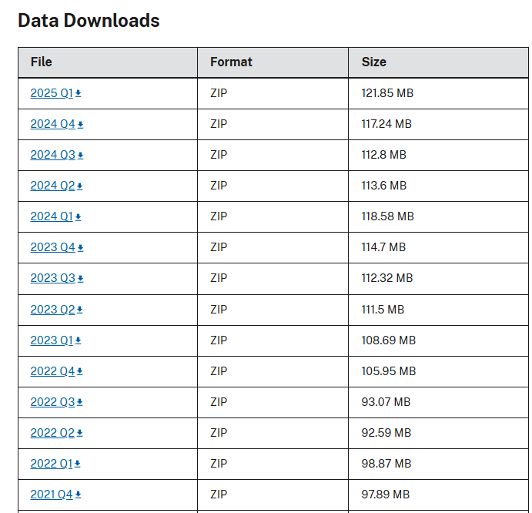
Data Analysis Process
Data Collection:
SEC Filings Posted on a Quarterly Basis, with 10-Q (Quarter) and 10-K (Annual) data
Each filing broken up into separate 4 .txt files housing different details
Data needed to be downloaded, extracted, concatenated, and formed into a valid dataframe
After extraction, appropriate financial tags needed to be identified, and relevant timeframes / annual filings were filtered
Courtesy of SEC.gov

Slide 6
Data Analysis Process
Selection of features were related primarily to financial reporting data:
Assets
Liabilities
Stockholder Equity
Net Income Loss
Revenues
Operating Income Loss
Current Assets
Current Liabilities
Cash on Hand
Retained Earnings & Accumulated Deficit
Gross Profit
Long Term Debt

Slide 7
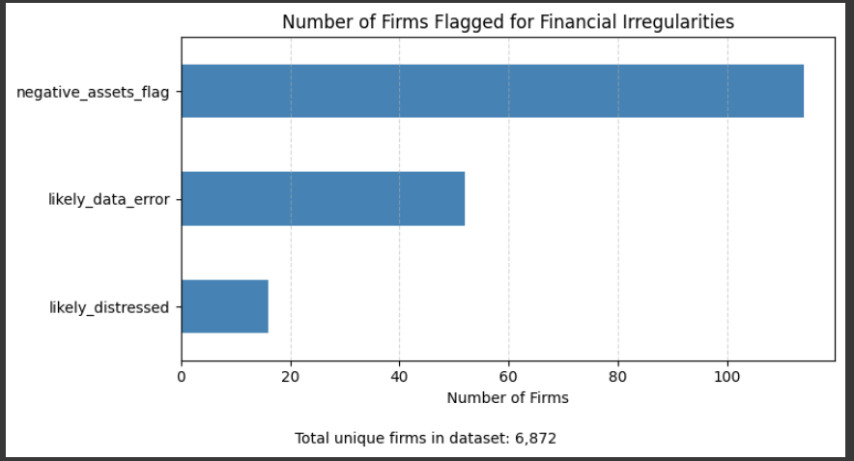
Data Analysis Process
Creation of Flags to Assist Model Training
Binary Columns added to identify:
Financially Distressed Firms
Likely Data Errors
Negative Assets
Missing Values
Binary flags were created to support the interpretation of outliers detected by the Isolation Forest Model

Slide 8
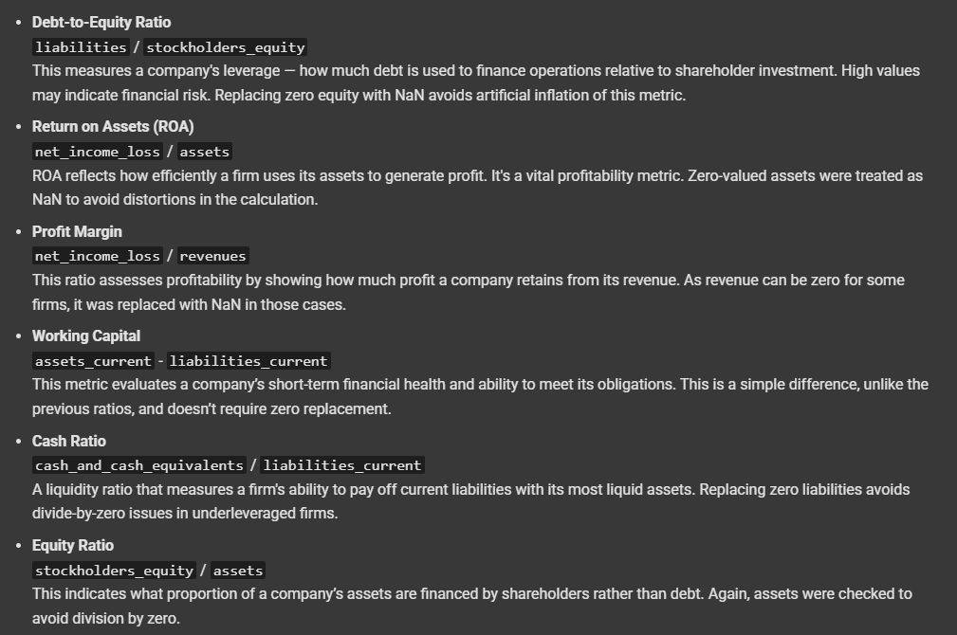
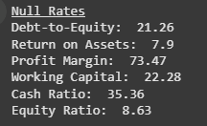
Data Analysis Process
Feature Engineering
Derived financial ratios were created from the existing dataset which are designed to reflect the business health and performance of individual firms, and provide deeper insight.
Null values in these ratios were identified to isolate firms that could be creating false or faulty filings and be flagged as anomalous

Slide 9
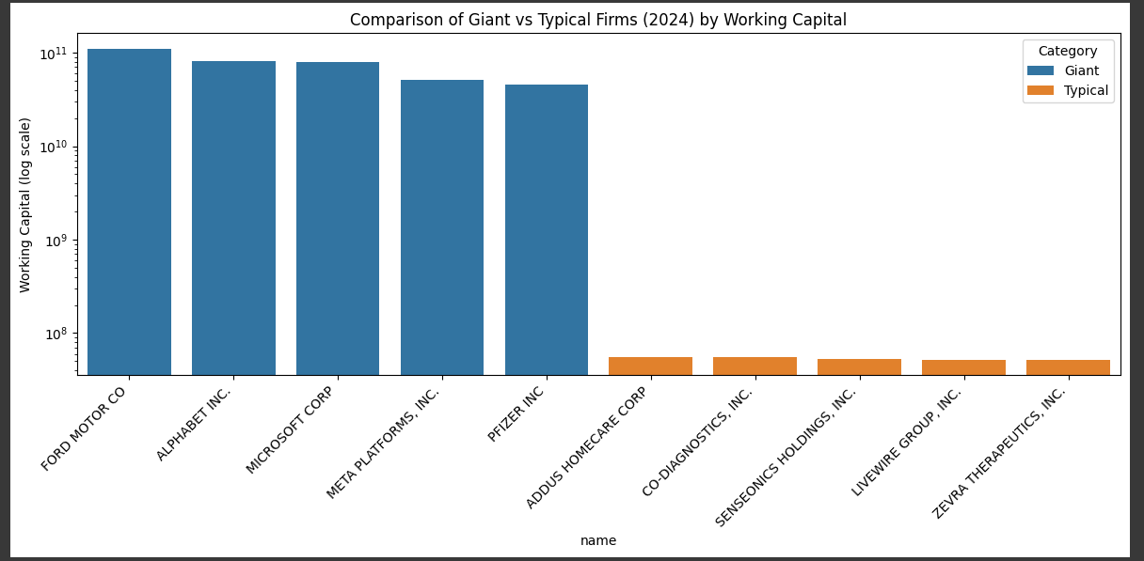
Data Analysis Process
Firm Size & Effect on Data
A special call out needs to be made for the size of some massive firms and their ratios effects on the data
This chart illustrates the relative size of mega corporations compared to “typical” firms in the dataset

Slide 10
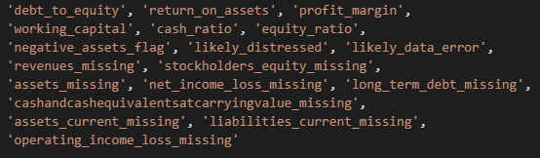


Data Analysis Process
Unsupervised Model Parameters
Selected Features
Engineered Financial Ratios
Binary Flags
Missing Value Flags
Imputed values
Median values
Model Metrics
100 estimators
0.05 Contamination Rate

Slide 11
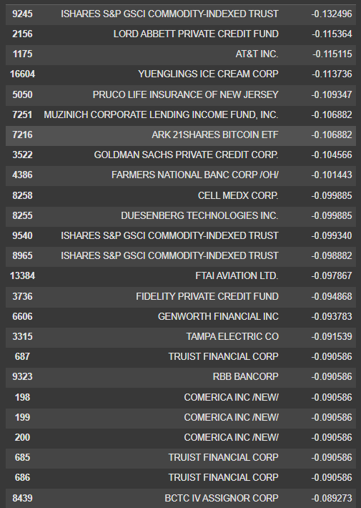
Findings
862 Firms flagged as anomalies
Several Giant firms are listed multiple times
Smaller firms also present
Points to the data preparation being adequate to ensure the model did not generalize to a single size

Slide 12
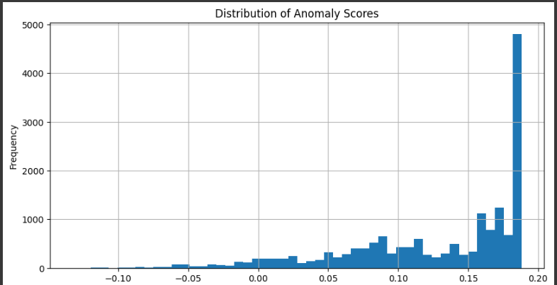
Findings
The efficacy of the model can not be measured with summary statistics
As an alternative, the distribution of the anomaly scores represented in the graph tell a story
Right side of the chart represents the frequency of firms between 0.15 and 0.2 anomaly scores representing “normal” behavior
Left side tail demonstrates a decreasing value, down to the negatives where anomalous filings existed at a higher rate

Slide 13
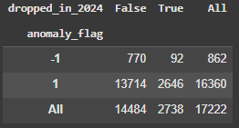

Findings
Comparison to Firms Dropped in 2024
Flag created to identify firms that went out of business
Looking to draw a correlation between anomalous firms and firms in financial trouble
Results showed 10.7% of anomalous firms dropped out, compared to 16.2% of non-anomalous firms
Statistical (Chi-Square) test results indicated a statistically significant association in this test, but the values were still less than was expected
Suggest the model may be detecting reporting irregularities or other deviations which would persist, as opposed to financial trouble as expected

Slide 14
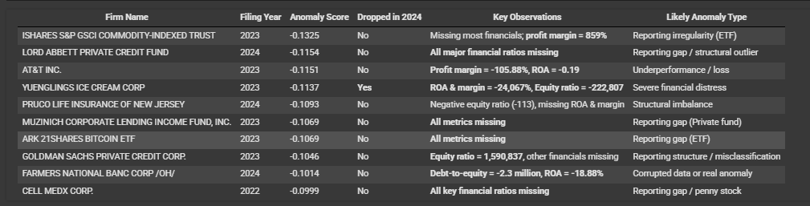
Findings
Top 10 Most Anomalous Firms

Slide 15
Limitations
Isolation Forest requires numeric or binary input, excluding textural disclosures which can be key indicators of failing financial firms
Isolation Forest does not offer predictive power in the sense of forecasting – it only flags data points that behave unusually compared to the rest of the dataset
Improper cleaning, filtering, or flagging can result in a poor fit to the data, or the model over-focusing on a subset

Slide 16
Summary & Expected Benefits
This project set out to collect, filter, clean and parse a complicated set of financial data
The model generated anomaly scores and identified firms whose financial profiles deviated significantly from their peers
Indicators such as extremely negative returns or implausible debt ratios were exposed
The results support the underlying theory that Machine Learning can reveal statistically anomalous patterns that correlate with risk and irregularity

Slide 17
Summary & Expected Benefits
Benefits, Recommendations & next steps
An investor or regulator with more robust resources could expand the model to capture quarterly financial data or add additional years to uncover longer periods of anomalous behavior
The model itself could have its parameters tuned to narrow or expand the scope and target more specific firms in violation
The data could be fed into a different ML model with more robust parameters to identify additional anomalies or even fraud and reporting failures
Machine Learning can be used to combat illegal or fraudulent firms, and automate review of financial firms to identify those in the most need of scrutiny

Slide 18
Sources & Citations
U.S. Securities and Exchange Commission. (n.d.). Seal of the U.S. Securities and Exchange Commission [Logo]. SEC.gov. https://www.sec.gov
U.S. Securities and Exchange Commission. (n.d.). SEC financial statement data sets. SEC.gov. https://www.sec.gov/data-research/sec-markets-data/financial-statement-data-sets

